Slide 1
Fair Use and Copyright Law Continued
A presentation by Mason Lanham

Slide 2

RIAA v. Diamond Multimedia
In 1998 Diamond Multimedia launched the Rio an MP3 Player without Serial Copyright Management System (SCMS)
Recording Industry Association of America (RIAA) tried to prevent its sale.
Court ruling determined that the Rio was not a digital recording device in accordance with Audio Home Recording Act of 1992
Space Shifting

Slide 3
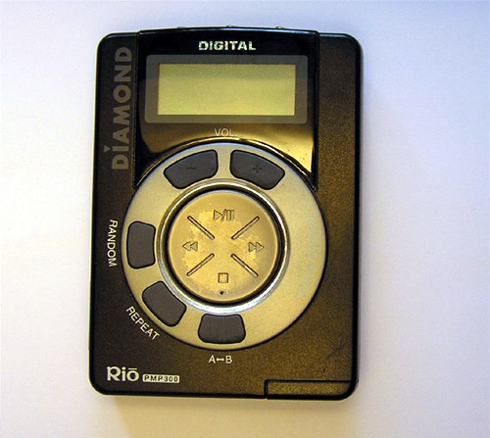

Slide 4
Kelly v. Arriba Soft
In 2002, Arriba Soft created a search engine that used Leslie Kelly’s images as thumbnails for the results of queries.
Kelly sued over the use of his images.
Court ruling determined that it was fair use because:
The use was transformative
Original value of images not harmed

Slide 5

Authors’ Guild v. Google
In 2004 Author’s Guild sued Google over their book database.
2013 Court ruling determined that it was fair use because:
The use was transformative
Many books were nonfiction
All books were published
Increases book sales

Slide 6

Digital Millennium Copyright Act
- Passed in 1998, first major revision since 1976.
- Made it illegal to circumvent encryption on digital media.
- Made online service provider more accountable.

Slide 7
Digital Rights Management (DRM)
Purpose is to track and control digital content once it enters the market
Examples:
Encrypting digital content so only usable by authorized users
Marking the original so that is the only usable copy
Criticisms:
Using technology for DRM will never work permanently
Undermines fair use
Prevents libraries from reformatting for people with disabilities
Violates privacy

Slide 8

Secure Digital Music Initiative
In 1998, about 200 companies worked to create copy protected CDs, and secure digital downloads.
Failed because:
Massive increase in music files on internet being copied during development
Consumer Electronics companies sales could be hurt by SDMI
Code was cracked by a Princeton team led by Edward Felten in “Hack SDMI” challenge issued by SDMI

Slide 9

Sony BMG Music Entertainment Rootkit
In 2005, Sony sold millions of Audio CDs with extended copy protection.
Monitored users listening habits and report this data to Sony
This was achieved by installing a rootkit on Windows computers when the CD was first played.

Slide 10
Sony BMG Music Entertainment Rootkit cont.
Rootkits hide files and processes from users.
This compromised users computer security.
It was discovered resulting in a class action lawsuit
Settled by Sony

Slide 11

Microsoft
In 2013, Microsoft Announced it would be creating a cloud-based experience for the XBOX ONE.
It included many restrictions:
Discs were only shareable once
Unable to buy or sell pre-owned games
XBOX would have to connect to internet once every 24 hours
Resulted in Controversy

Slide 12
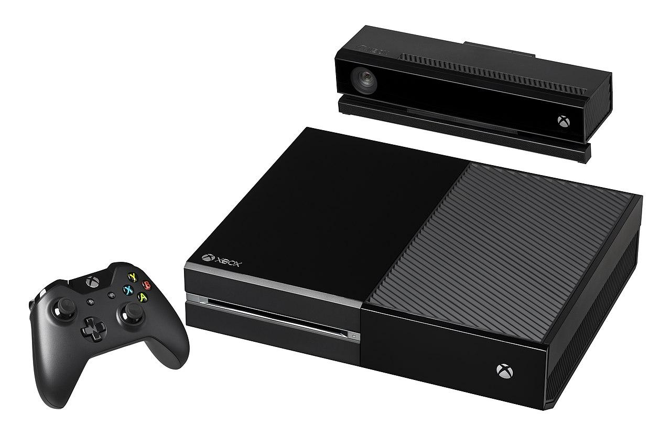
Microsoft XBOX ONE cont.
A Facebook poll by Amazon showed the Sony PS4 was becoming much more popular
Microsoft realized their plans would have to be dropped.

Slide 13

Peer-to-Peer Networks and Cyberlockers
Peer-to-Peer Networks allow computers to connect with each other to access files stored on others hard drives.
Cyberlockers aka file-hosting services or cloud storage services allow users to upload files which they can share with others.

Slide 14

RIAA Lawsuit against
In 1999, Napster was sued for copyright infringement.
Court ruling required Napster to block users from trading copyrighted content.
Unable to be 100% blocked.
Shutdown, until they later reemerged as a music service and store.

Slide 15

RIAA Lawsuits against Kazaa users
In 2003 Grokster and Kazaa users were warned to in a letter not to share copyrighted files.
RIAA identified Kazaa supernodes where most copyrighted files stored.
RIAA invoked the DMCA to ask Verizon for the names of those users.
RIAA sued 261 individuals and sent letters to 204 others giving them a chance to settle before being sued.

Slide 16

MGM v. Grokster
MGM (the movie company) and others sued Grokster and StreamCast for the copyright infringement of their users.
90% of Grokster’s available files were copyrighted, and both companies supported and promoted the sharing of copyrighted content on their sites.
District Court ruling
Supreme Court Reversal
Grokster shutdown

Slide 17

BitTorrent
Normally, upload speeds are 1/10th the speed of downloads.
BitTorrent solved this problem for peer-to-peer networks by dividing files into quarter megabyte chunks and distributing them across multiple computers.
This results in faster downloads as the file being shared becomes more popular.

Slide 18
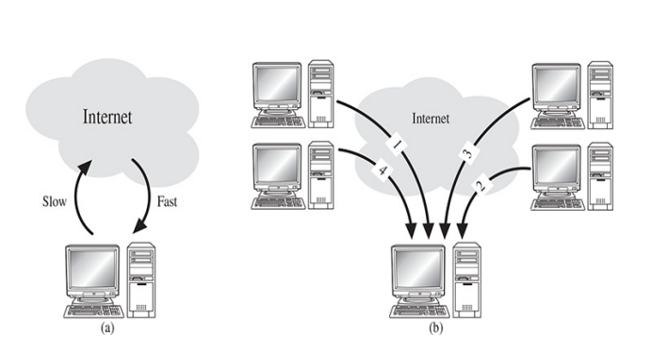

Slide 19

The Pirate Bay
Established in 2003, and based in Stockholm, Sweden it’s one of the biggest file sharing websites with 25 million users.
Uses BitTorrent to allow users to download copyrighted media for free.
In 2006 it’s offices were raided by Swedish government.
Offline for 3 days, reemerged more popular.

Slide 20

PRO-IP Act and Megaupload Shutdown
2008 Prioritizing Resources and Organization for Intellectual Property
2010 Operation In Our Sites.
In 2012 Megaupload (a cyber locker) was shutdown.

Slide 21
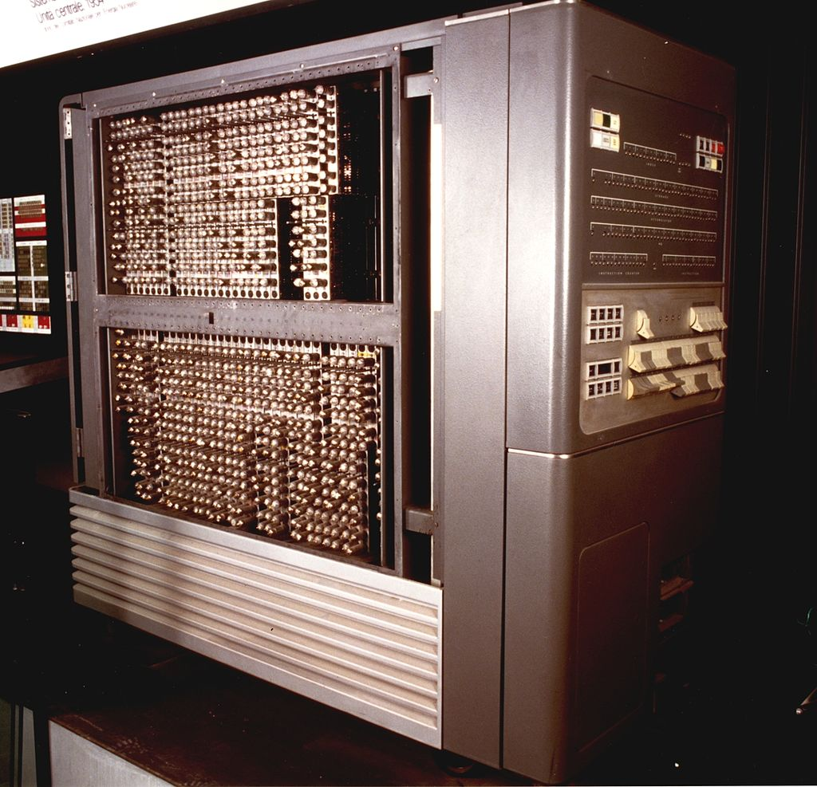
Software Copyrights
Originally, complete systems were sold.
Independent software industry begins in the 1960’s.
First Software copyrights were issued in 1964.
Copyright Act of 1976

Slide 22
Software Copyright cont.
How does Software Copyright Work?
It protects the expression of an idea.
Example: Relational Database
Protects the executable and screen displays
Doesn’t protect source code

Slide 23
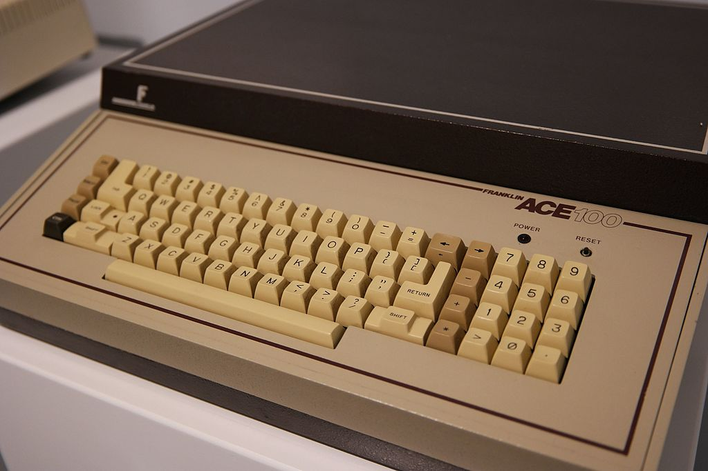
Apple Computer v. Franklin Computer
In the Early 80’s Franklin Computer made the Franklin ACE.
It was compatible with Apple II software.
It copied parts of the Apple II’s OS
By Kevin Savetz - SAM_0649, CC BY 2.0, https://commons.wikimedia.org/w/index.php?curid=50293401

Slide 24
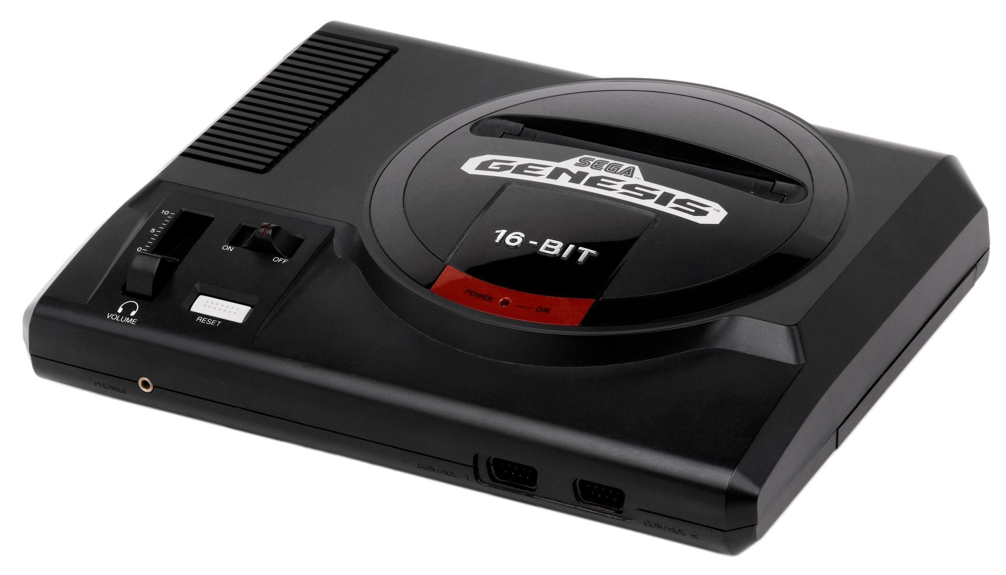
Sega v. Accolade
Accolade wanted to port its games to the Sega Genesis
Normally requires a licensing deal.
Worked around by reverse engineering the interface with the Genesis
In 1992, Sega Sued but it was ruled to be fair use because
Accolade had no choice but to reverse engineer to avoid the licensing deal
The public could benefit from a wider range of games

Slide 25
“Clean Room” Development
Created to avoid copying code.
2 independent teams.
1st team creates a technical specification from source code and other material.
2nd team uses this technical specification for development.

Slide 26
Questions?

Slide 27
Image Credits 1
“CD-ROM.” Wikipedia, Wikimedia Foundation, 20 Mar. 2022, https://en.wikipedia.org/wiki/CD-ROM#/media/File:CD-ROM.png.
Choney, Suzanne. “No Googling, Says Google - Unless You Really Mean It.” NBCNews.com, NBCUniversal News Group, 26 Mar. 2013, https://www.nbcnews.com/technolog/no-googling-says-google-unless-you-really-mean-it-1c9078566.
“Diamond Multimedia.” Wikipedia, Wikimedia Foundation, 30 Mar. 2022, https://en.wikipedia.org/wiki/Diamond_Multimedia#/media/File:Diamond_Multimedia_logo.svg.
“File:Bittorrent Logo.svg.” Wikimedia Commons, Wikimedia Foundation, https://commons.wikimedia.org/wiki/File:BitTorrent_logo.svg.
“File:Napster Corporate Logo.svg.” Wikipedia, Wikimedia Foundation, 29 Sept. 2020, https://en.wikipedia.org/wiki/File:Napster_corporate_logo.svg.
“File:Netflix 2015 Logo.svg.” Wikipedia, Wikimedia Foundation, https://en.wikipedia.org/wiki/File:Netflix_2015_logo.svg#/media/File:Netflix_logo.svg.
“File:Sonybmg-Logo.svg.” Wikimedia Commons, Wikimedia Foundation, https://commons.wikimedia.org/wiki/File:Sonybmg-logo.svg.

Slide 28
Image Credits 2
“File:Sonybmg-Logo.svg.” Wikimedia Commons, Wikimedia Foundation, https://commons.wikimedia.org/wiki/File:Sonybmg-logo.svg.
“Google Drive.” Wikipedia, Wikimedia Foundation, 4 Mar. 2022, https://en.wikipedia.org/wiki/Google_Drive#/media/File:Google_Drive_icon_(2020).svg.
“IBM 704.” Wikipedia, Wikimedia Foundation, 26 Mar. 2022, https://en.wikipedia.org/wiki/IBM_704#/media/File:Unit%C3%A0_centrale_-_Museo_scienza_tecnologia_Milano_D1260_foto.jpg.
“ITunes.” Wikipedia, Wikimedia Foundation, 11 Mar. 2022, https://en.wikipedia.org/wiki/ITunes#/media/File:ITunes_12.2_logo.png.
“Pandora (Streaming Service).” Wikipedia, Wikimedia Foundation, 20 Mar. 2022, https://en.wikipedia.org/wiki/Pandora_(streaming_service)#/media/File:Pandora_wordmark.svg.
“The Pirate Bay.” Wikipedia, Wikimedia Foundation, 28 Mar. 2022, https://en.wikipedia.org/wiki/The_Pirate_Bay#/media/File:The_Pirate_Bay_logo.svg.

Slide 29
Image Credits 3
Princeton University, The Trustees of Princeton University, 2022, https://www.princeton.edu/.
“Rio PMP300.” Wikipedia, Wikimedia Foundation, 12 July 2021, https://en.wikipedia.org/wiki/Rio_PMP300#/media/File:Rio_pmp300.jpg.
Savetz, Kevin. “Franklin Electronic Publishers.” Wikipedia, Wikimedia Foundation, 7 Mar. 2022, https://en.wikipedia.org/wiki/Franklin_Electronic_Publishers#/media/File:Franklin_Ace_1000_Apple_2_clone_(16741693633).jpg.
“Sega Genesis.” Wikipedia, Wikimedia Foundation, 20 Feb. 2022, https://en.wikipedia.org/wiki/Sega_Genesis#/media/File:Sega-Genesis-Mod1-Bare.jpg.
“Spotify.” Wikipedia, Wikimedia Foundation, 30 Mar. 2022, https://en.wikipedia.org/wiki/Spotify#/media/File:Spotify_logo_with_text.svg.
“Xbox One.” Wikipedia, Wikimedia Foundation, 18 Mar. 2022, https://en.wikipedia.org/wiki/Xbox_One#/media/File:Xbox_One_logo_wordmark.svg.

Slide 30
References
Quinn, Michael J. “Chapter 4 Intellectual Property.” Ethics for the Information Age, 7th ed., Pearson Education, Harlow, England, 2017.
“Sega V. Accolade.” Wikipedia, Wikimedia Foundation, 20 Mar. 2022, https://en.wikipedia.org/wiki/Sega_v._Accolade.

